Slide 1
Fire Safety System Team 2
Assignment 3
By Eoin, Leah and Tommy

Slide 2
90%
Team 2
Over 90% of fire related deaths are caused by smoke suffication, and not by high tempatures or burning.

Slide 3
How it works
1
2
3
4
5
Smoke is detected
With the MQ2 Smoke detector
Emergency Services are automatically informed
Alarm and Escape lights are triggered
Automatic exaust vents open
Fans suck smoke and away from the fire

Slide 4
Materials
Team 2
Arduino Uno
1x LCD Screen 16x2
1x MQ2 Smoke Sensor
1x Servo Motor
1x DC Motors
MDF

Slide 5
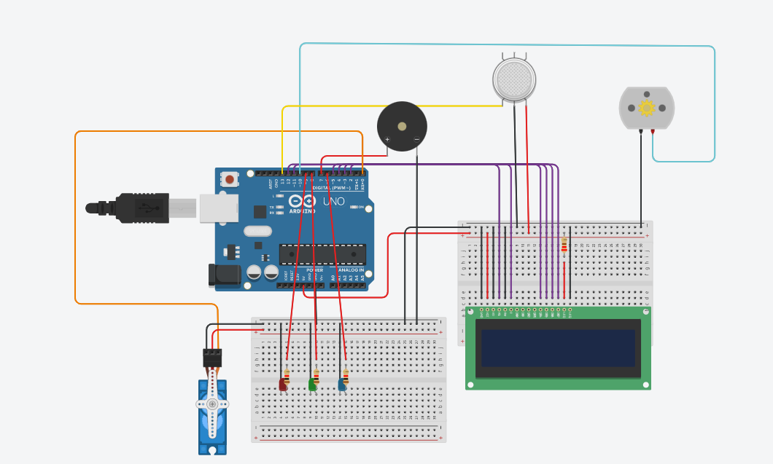
Schematics

Slide 6
Code
byte blFire[] = {
B11111,
B11111,
B11111,
B01111,
B01111,
B00111,
B00011,
B00001
};
byte brFire[] = {
B11101,
B11111,
B11111,
B11111,
B11110,
B11100,
B11000,
B10000
};
byte trFire[] = {
B10000,
B00000,
B10000,
B10000,
B11000,
B11000,
B11100,
B11100
};
byte tlFire[] = {
B00000,
B00001,
B00011,
B00011,
B00111,
B00111,
B10111,
B11111
};

Slide 7
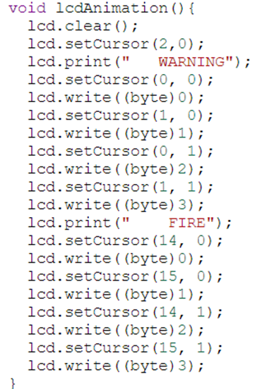

Code

Slide 8
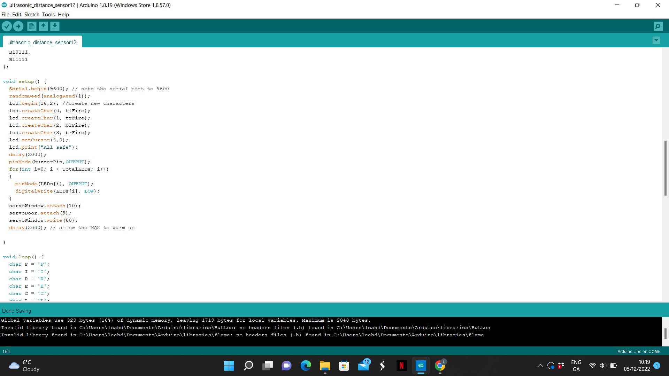
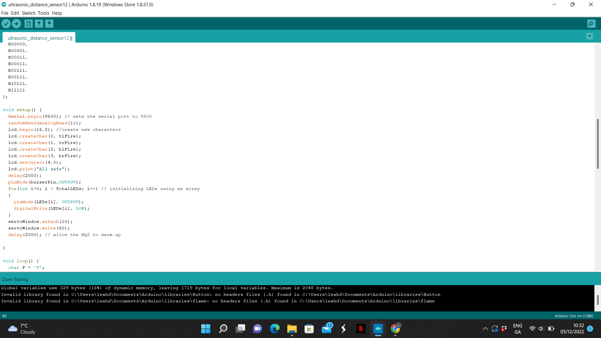
Code

Slide 9
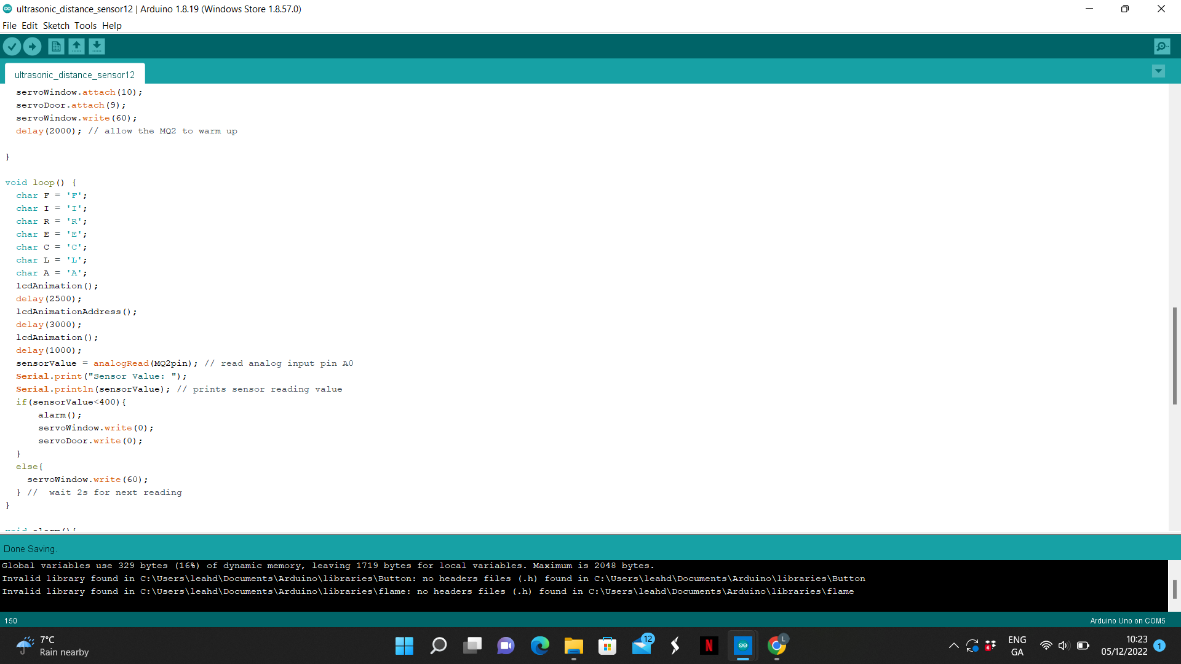
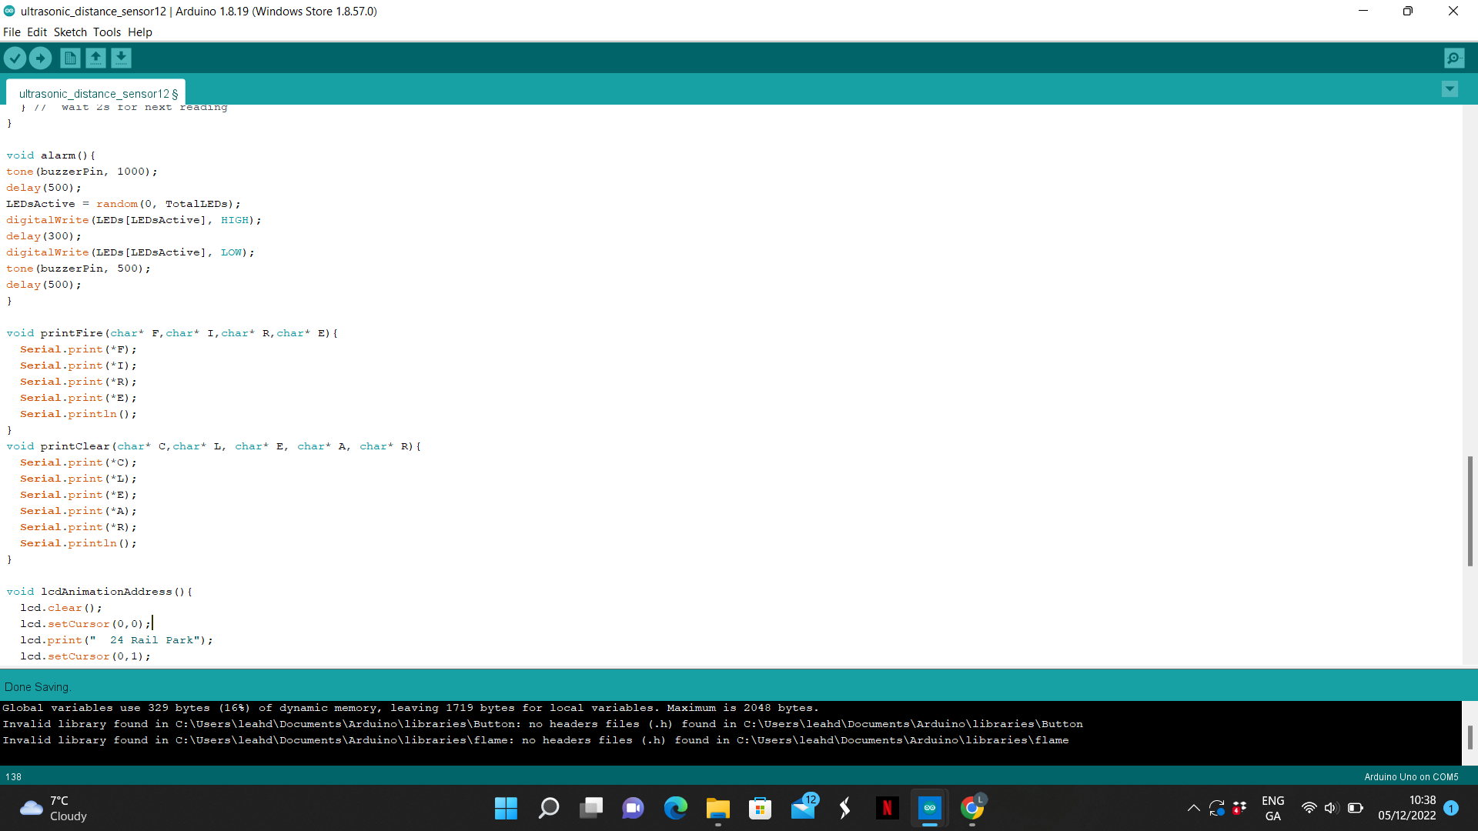
Code

Slide 10
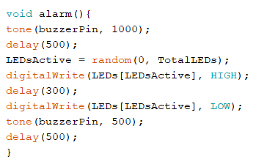
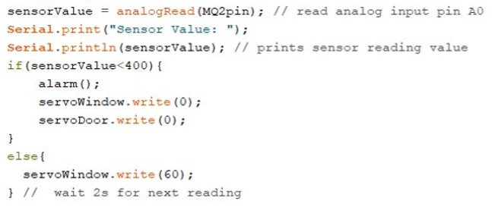
Code

Slide 11
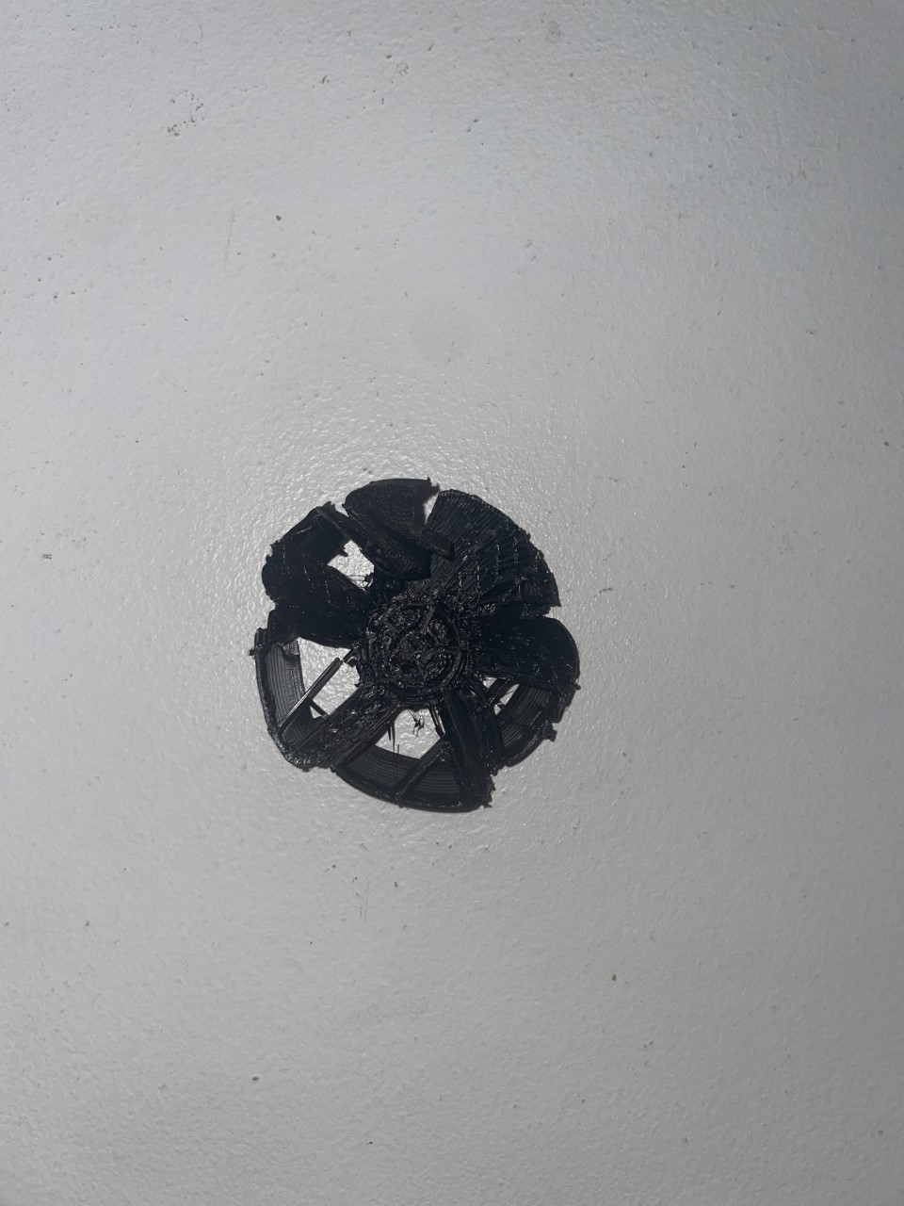
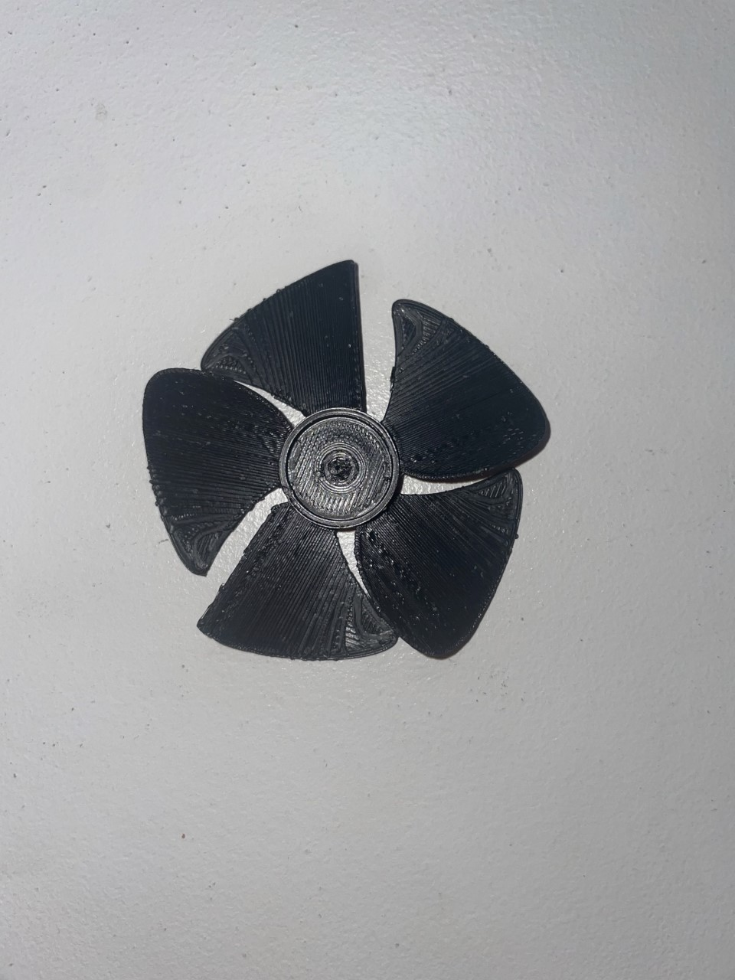

Challenges

Slide 12
Improvements
Add more servos to open doors and windows.
Solder parts together to prevent wires from coming loose.
Integrate the system with phone application.

Slide 13
Conclusions
Built our first fully physical system.
Created a system the senses the environment
Integrated a sensor into a system with physical response

Slide 14
Thanks for Listening
Team 2

Slide 15
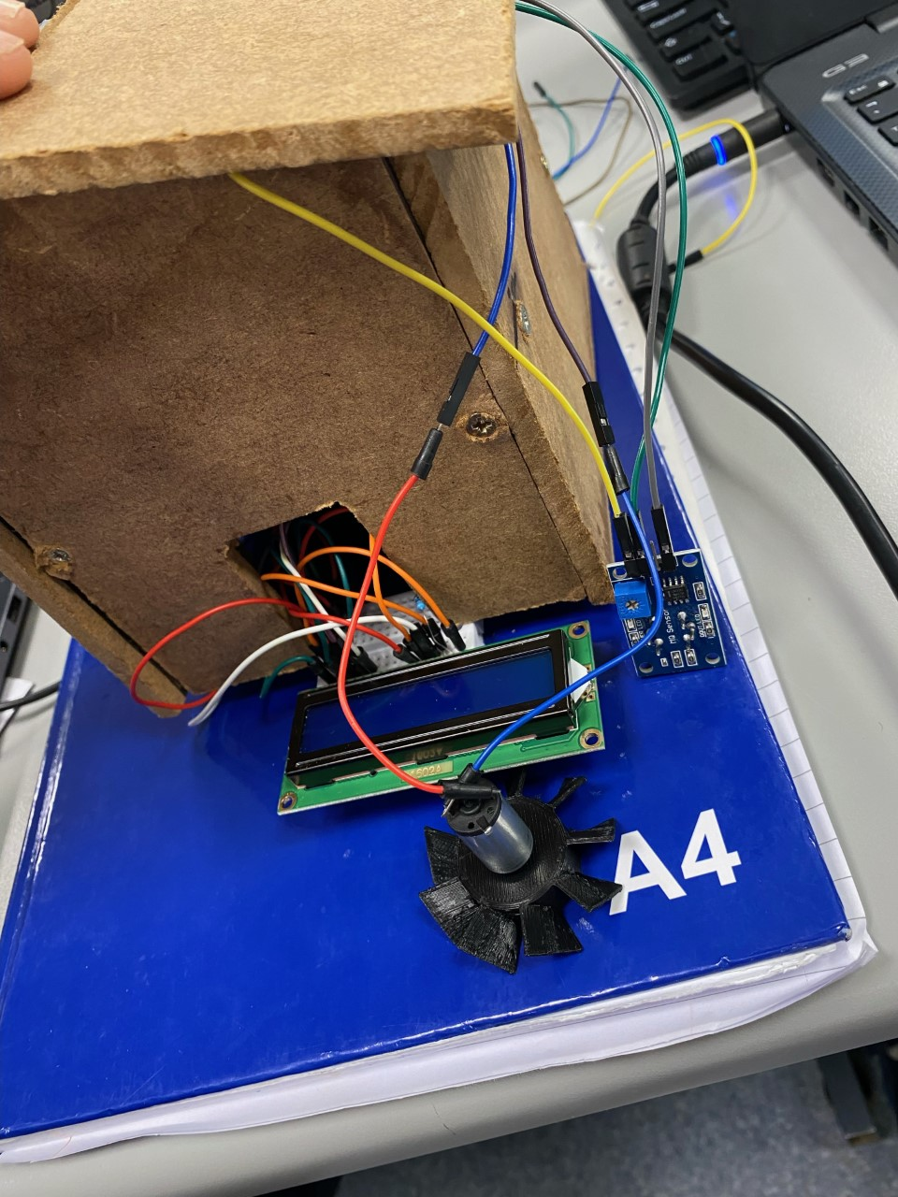
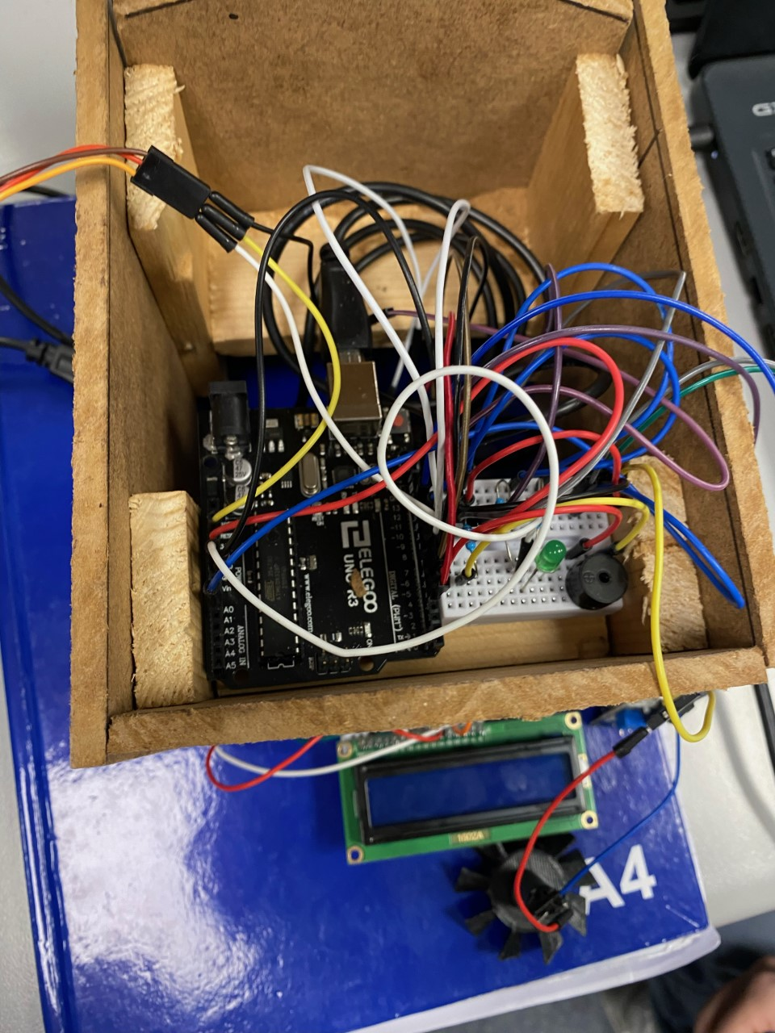
Team 2

Slide 16
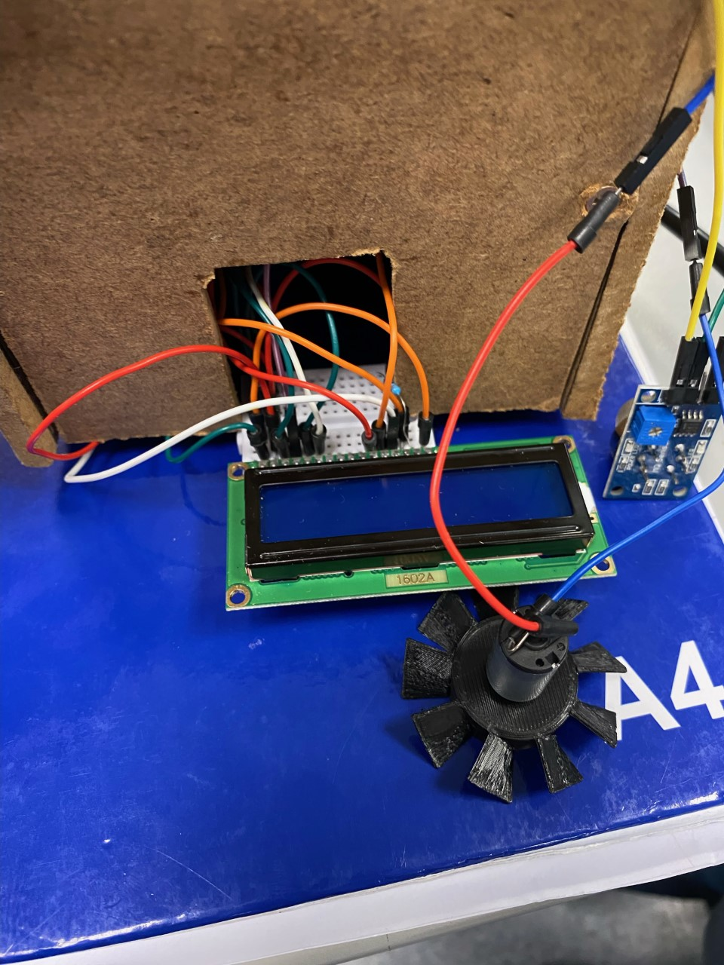
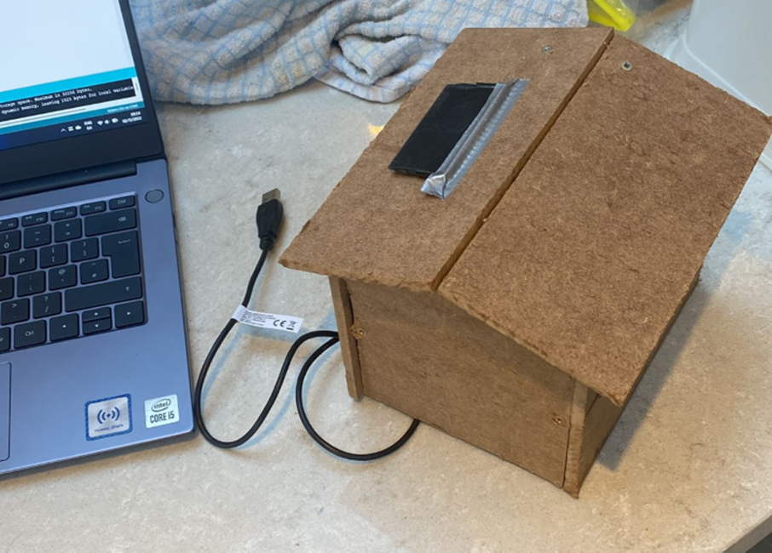
Team 2

